Slide 1
SMART MEDICAL PRODUCTS MANAGEMENT SYSTEM
Batch Number: 10
Team Number: Team 3
Team Members: Srishty Shekhar Keerthan Karthikeya Vaggala Prathyusha Yekamba Nitish Kumar Chaudhary Chintala Keerthana

Slide 2

Introduction
Smart system to manage inventory digitally
Needed to handle large and complex stock
Solves stock shortage and overstock issues
Prevents use of expired products

Slide 3

Objectives
To explain the concept of smart medical inventory management
1
2
To study how digital technology improves safety, accuracy, and availability of medical products in healthcare organizations
3
To learn real-time applications in healthcare systems
To understand digital tracking of medicines and medical products
4

Slide 4
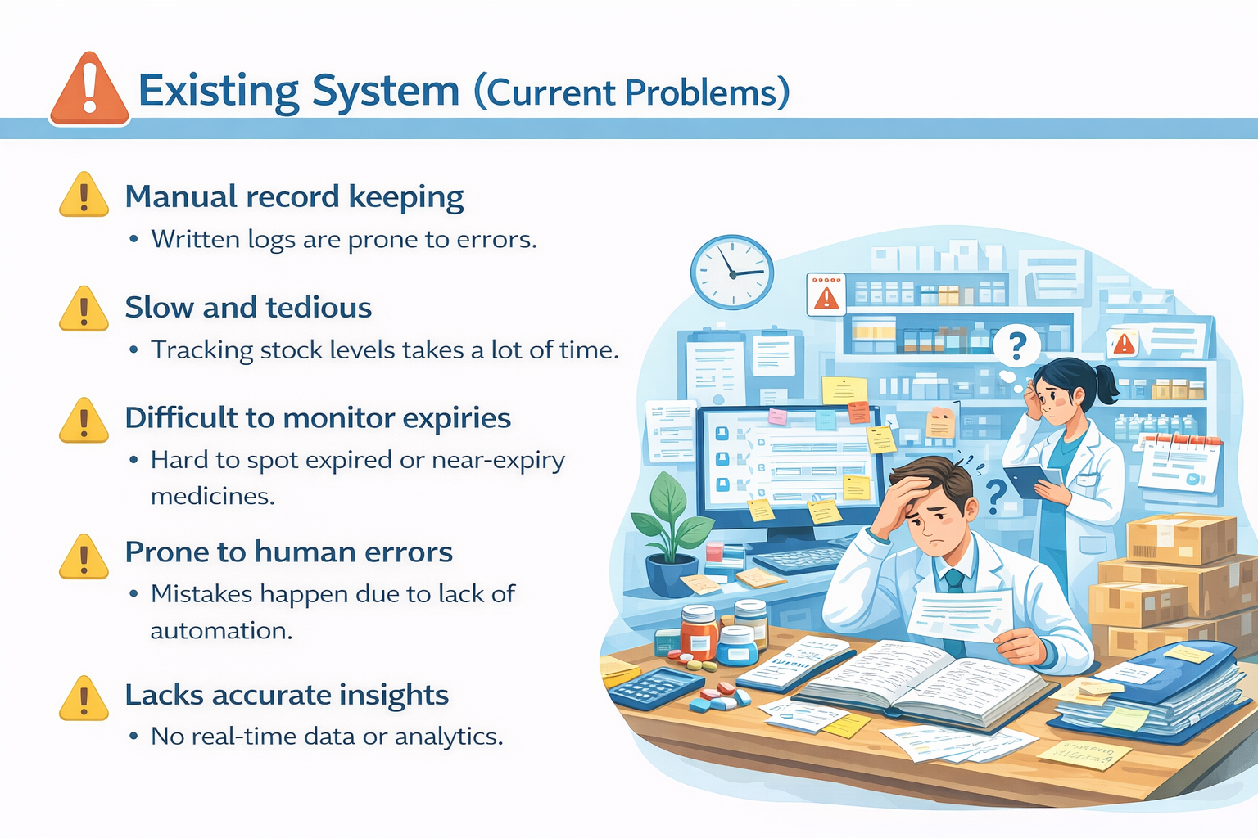
Existing System
Inventory maintained manually
Difficult to track stock quantity
Expiry dates not monitored properly
High chances of human errors
Time-consuming record updates
No real-time information

Slide 5
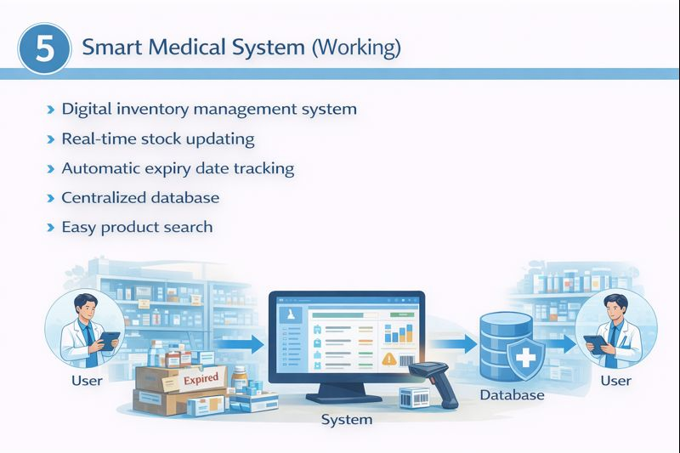
Smart Medical System
Automatic expiry date tracking
Digital inventory management system
Real-time stock updating
Centralized database
Easy product search

Slide 6
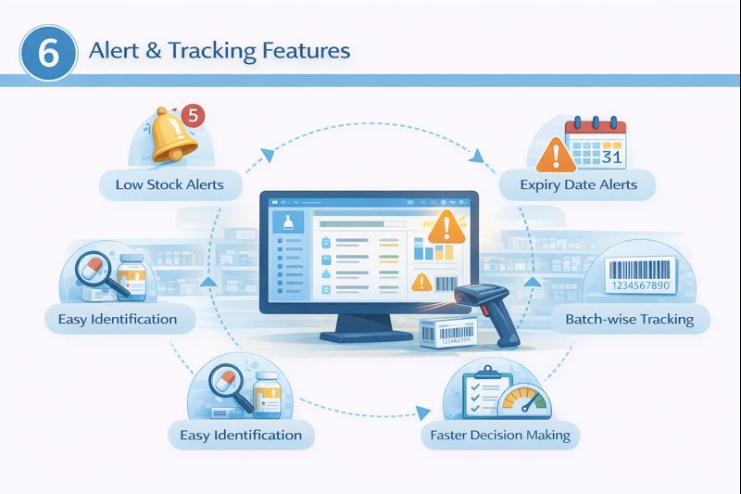
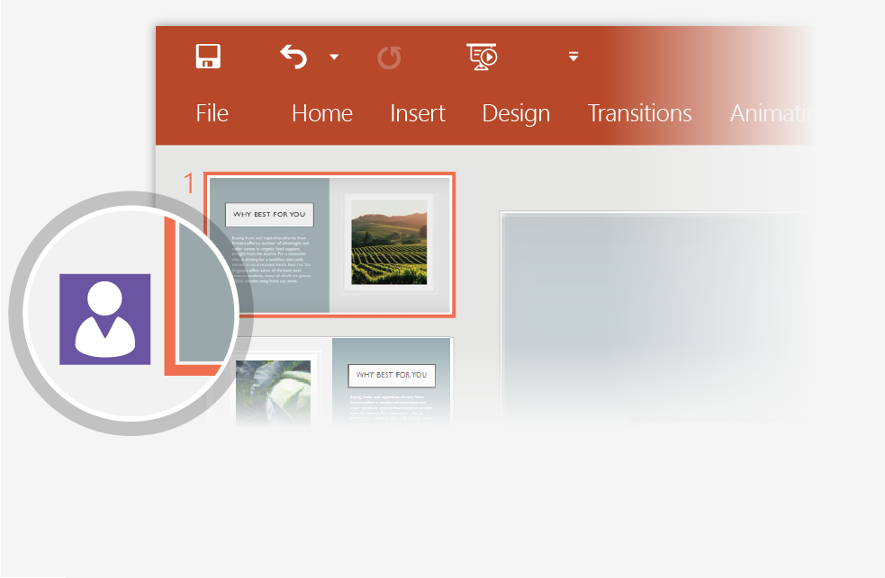
Alert & Tracking Features
Monitors stock levels continuously
Sends low stock alerts
Sends expiry date alerts
Tracks products batch-wise
Shows notifications on dashboard
2
When other people are in the presentation, a marker shows who is on which slide…
3

Slide 7

Module 1 : Authentication
Problem:
Multiple users accessing sensitive healthcare data
Risk of unauthorized access and data misuse
Lack of accountability and compliance issues
Solution:
Secure login with unique credentials
Role-based access control
Password encryption and session management

Slide 8
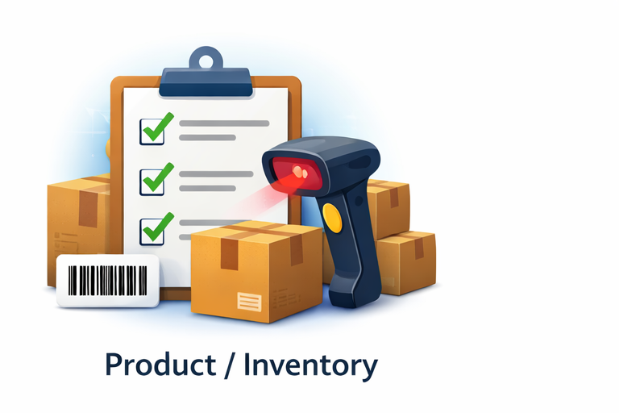
Module 2 : Product Management
Problem:
Manual tracking leads to inaccurate stock records
Risk of expired products and shortages
No real-time visibility across locations
Solution:
Batch-wise, expiry-aware, location-based tracking
Real-time stock updates with FEFO logic
Automatic blocking of expired products
Synchronized inventory data across units

Slide 9
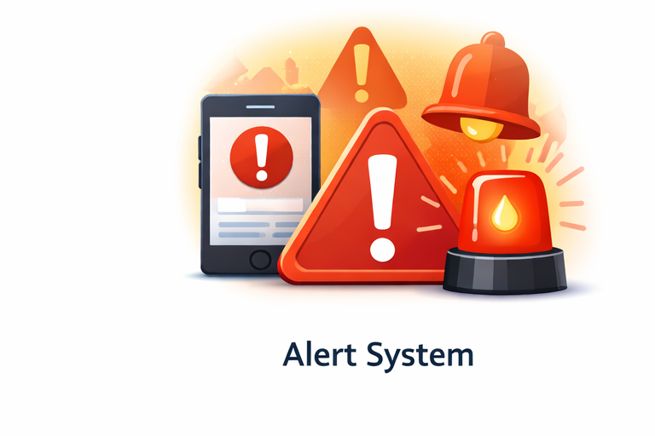
Module 3 : Inventory/Alerts
Problem:
Low stock, near-expiry, and delayed transfers go unnoticed
Manual monitoring is error-prone
Causes shortages and wastage
Solution:
Continuous inventory monitoring
Automatic alerts for low stock, near-expiry, damaged goods, delayed transfers
Timely notifications for proactive action

Slide 10

Module 4 : Reports & Analytics
Problem:
Limited monitoring and reporting
Poor demand prediction
Reactive decision-making
Solution:
Dashboards and reports on inventory, usage, expiry, and transfers
Data-driven insights for decision-making
Supports forecasting, compliance, and operational optimization

Slide 11
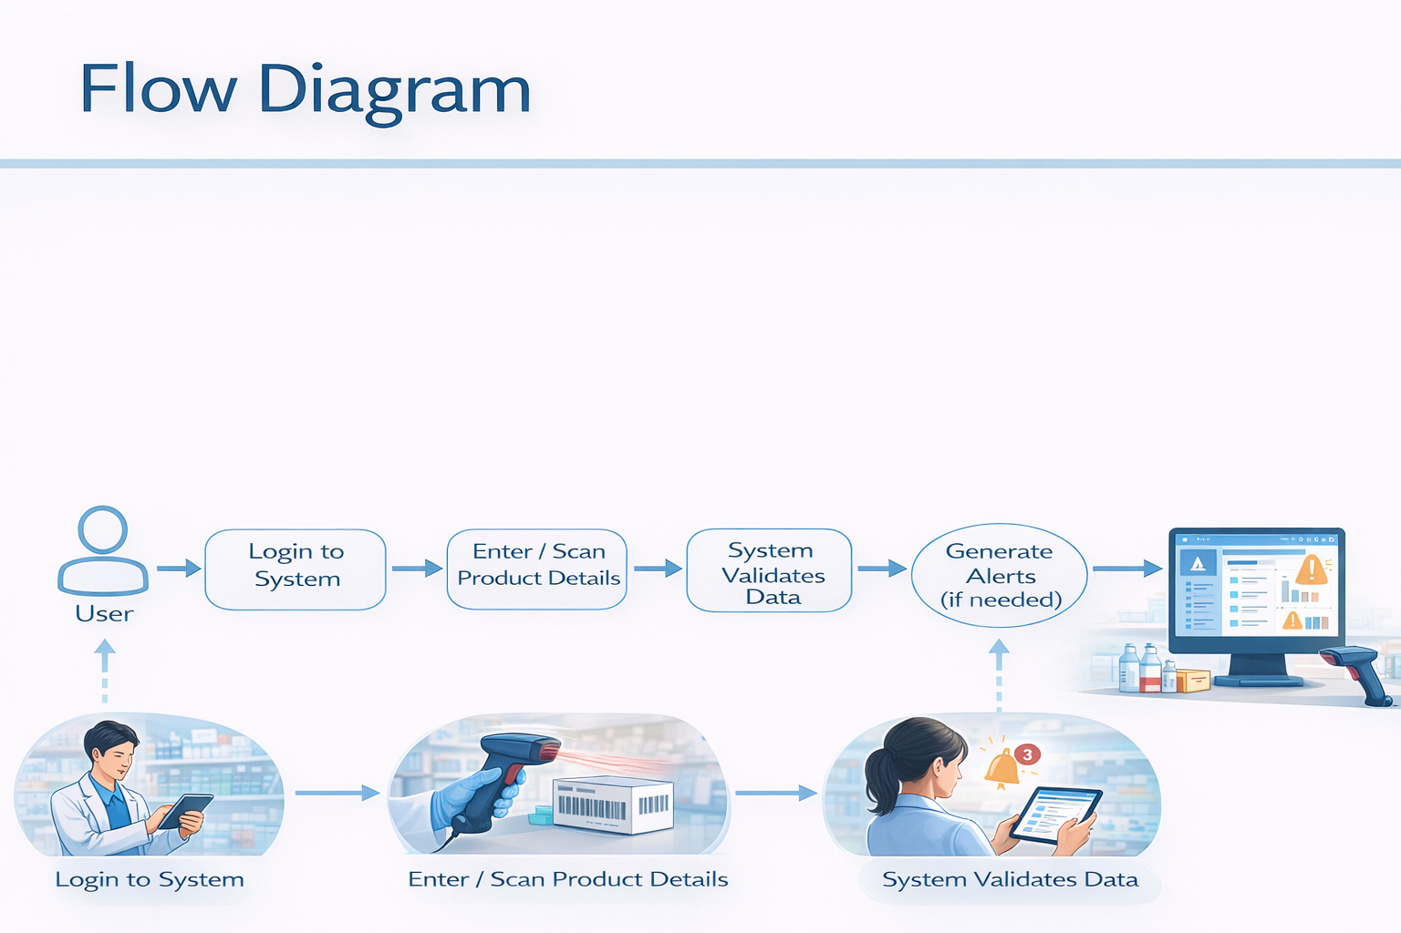
Flow Diagram
User logs into the system
Enters or scans product details
System validates the information
Stock data is updated in database
System checks stock level and expiry
Alerts are generated if needed
Updated details shown on dashboard

Slide 12
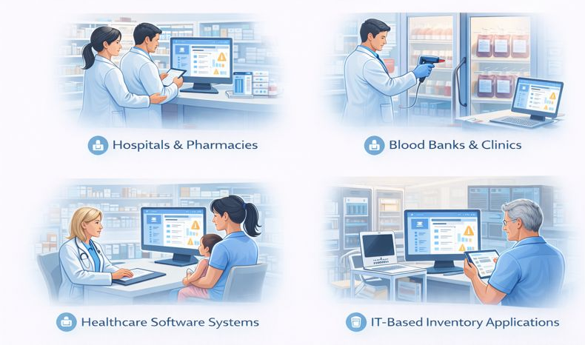
Practical Example
Used in hospitals and pharmacies
Used in blood banks and clinics
Used in healthcare software systems
Used in IT-based inventory applications

Slide 13
Advantages
Saves time
Reduces manual errors
Improves stock accuracy
Prevents expired product usage
Better inventory control

Slide 14

Limitations
Depends on internet and power supply
Initial implementation cost
Staff training required
System maintenance needed
Data security concerns

Slide 15
Conclusion
Ensures accurate stock management
Reduces errors in inventory tracking
Maintains optimal inventory levels
Improves healthcare efficiency
Supports timely patient care

Slide 16
Thank You Any Questions?

